Slide 1



AI Village Capture the Flag @ DEFCON
Chengyu Lai
Notes:
Recommending picking out he most interesting and important parts from your documentation.

Slide 2
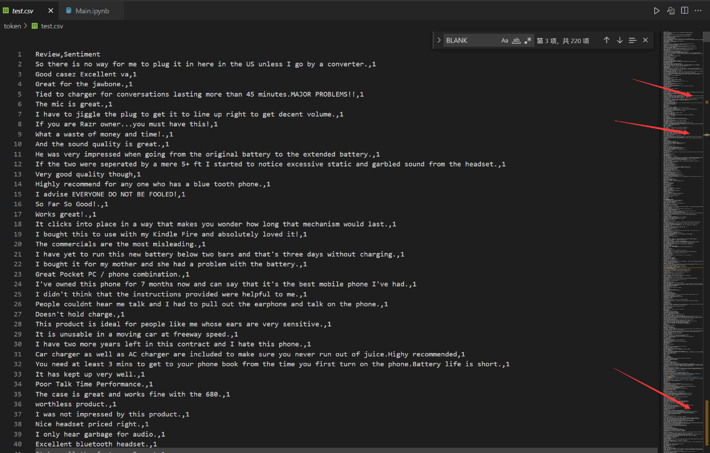
token
CTRL+F find BLANK you can 2 outliers,so … you can guess the answer.

Slide 3
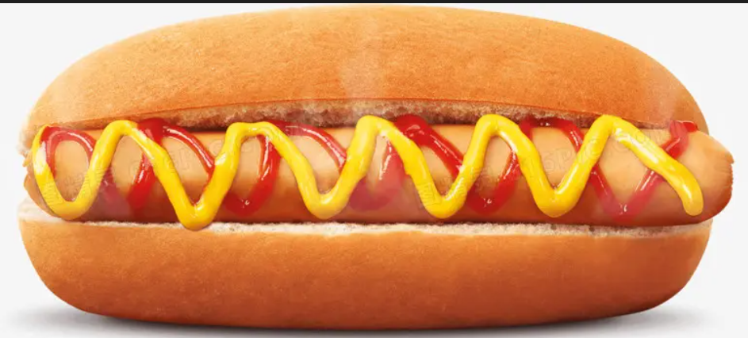
hotdog
Find a hotdog picture.

Slide 4
Math
Math1-3
brute-force search
Enumeration 111-999
Math4
The purpose is to obtain the order of cluster size
Enumerate all permutations

Slide 5

honorstudent
Ps is all you need.

Slide 6

Hotterdog,theft, salt
Use the way in https://tcode2k16.github.io/blog/posts/picoctf-2018-writeup/general-skills/#solution-20
The salt need change the threshold to 0.02

Slide 7
Bad2Good
Adjust the parameters of certain columns to extreme values.

Slide 8
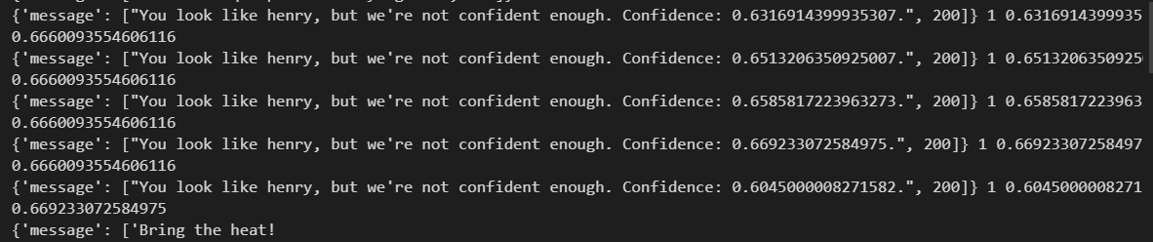
baseball
Hill Climbing Algorithm
keep trying to make the situation favorable
Define a favorable situation as currently being henry and increasing probability, or not being henry and decreasing probability

Slide 9
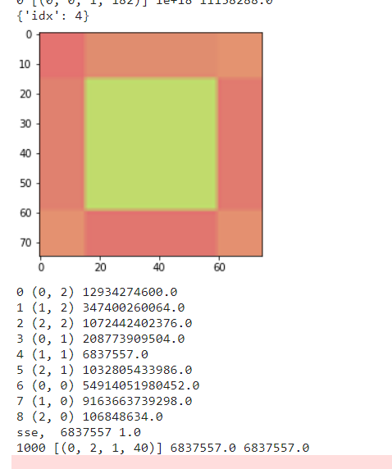
crop
Hill Climbing Algorithm
First let the score for the center drop below 1e7, because the sides drop to at most 1.3e7 and the corners to 1.7e7
Finally let the model choose the center point

Slide 10
forensics
model.summary()

Slide 11
inference
Hill Climbing Algorithm
Let the model give a very high probability about the image

Slide 12
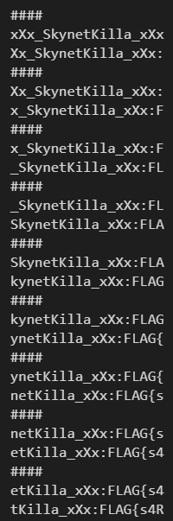
leakage
Loop the input string and concatenate the argmax output

Slide 13
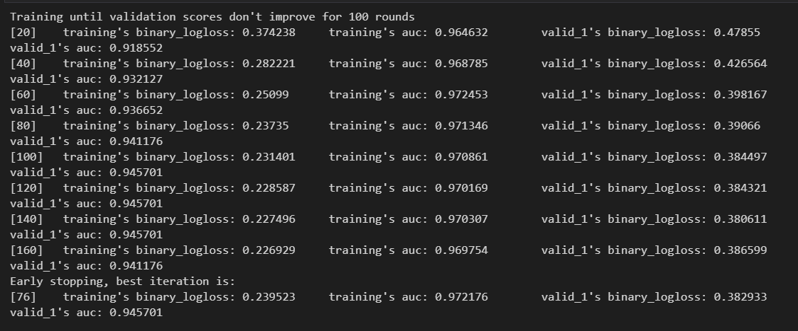
murderbots
Use lightgbm, set the top 10 samples to 1, set the other to 0
Auc can be 0.94

Slide 14
waf
Try to add char before the string, get the whole dangerous string.
Decode it, then attack /bin/bash () { :;};

Slide 15

deepfake
In this problem, our goal is to make the model recognizes the face in the video as a normal one, while recognizing the video as the excat video given by the problem.
As we can see, there are some frames in the video which contain a normal face. I crop the face and put it at the top of the original video by PR, making it moving along with the lady’s head. Consequently, it successfully cheat the model.
Kaggle Winner Presentation Template

Slide 16
wifi
Sort the input array by std, and then output the corresponding characters

Slide 17

secret.sloth
fftpack.fft2

Slide 18


